Slide 1
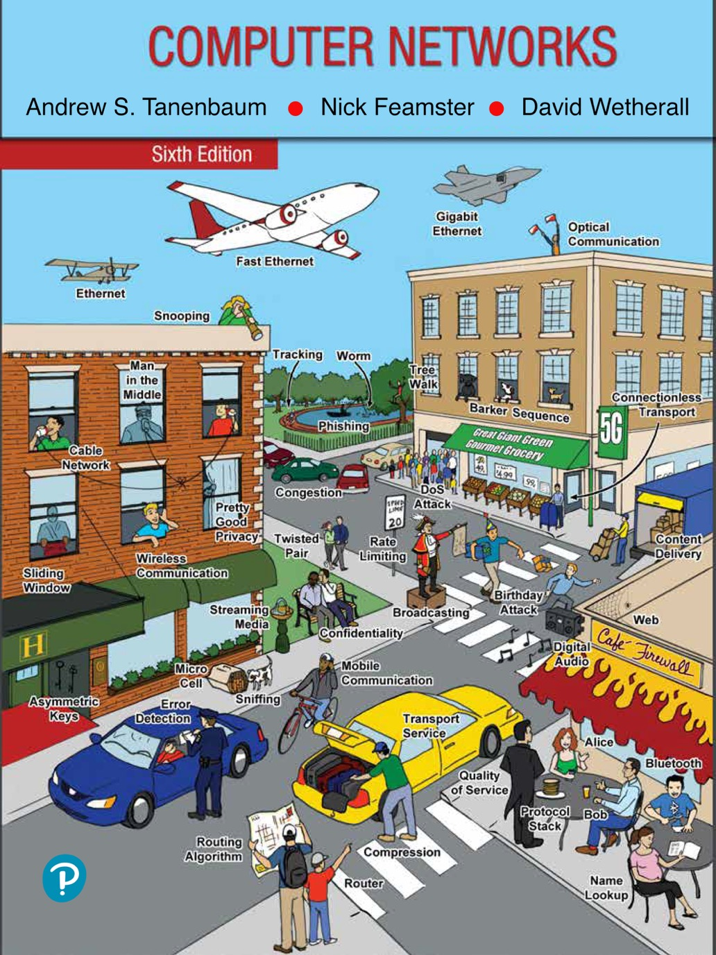
Chapter 4
The Medium Access Control Sublayer

Slide 2
Medium Access Control
In any broadcast network, the key issue involves determining who gets to use the channel when there is competition for it.
The protocols used to determine who goes next on a multiaccess channel belong to a sublayer of the data link layer called the MAC (Medium Access Control) sublayer.
Especially important in LANs, particularly wireless ones because wireless is naturally a broadcast channel.

Slide 3
The Channel Allocation Problem
Static channel allocation
Assumptions for dynamic channel allocation

Slide 4
Static Channel Allocation
Static allocation
Poor fit to computer systems with extremely bursty data traffic
Performance affected when peak traffic to mean traffic ratios are 1000:1
Most channels will be idle most of the time
Dynamic allocation tries to resolve static allocation problems

Slide 5
Assumptions for Dynamic Channel Allocation
Independent traffic
Single channel
Observable collisions
Continuous or slotted time
Carrier sense or no carrier sense

Slide 6
Multiple Access Protocols
ALOHA
Carrier Sense Multiple Access
Collision-free protocols
Limited-contention protocols
Wireless LAN protocols

Slide 7
ALOHA (1 of 4)
Pure ALOHA: send the frame when ready, resend if the frame is destroyed
Slotted ALOHA: required to wait to send a frame for the beginning of the next slot

Slide 8
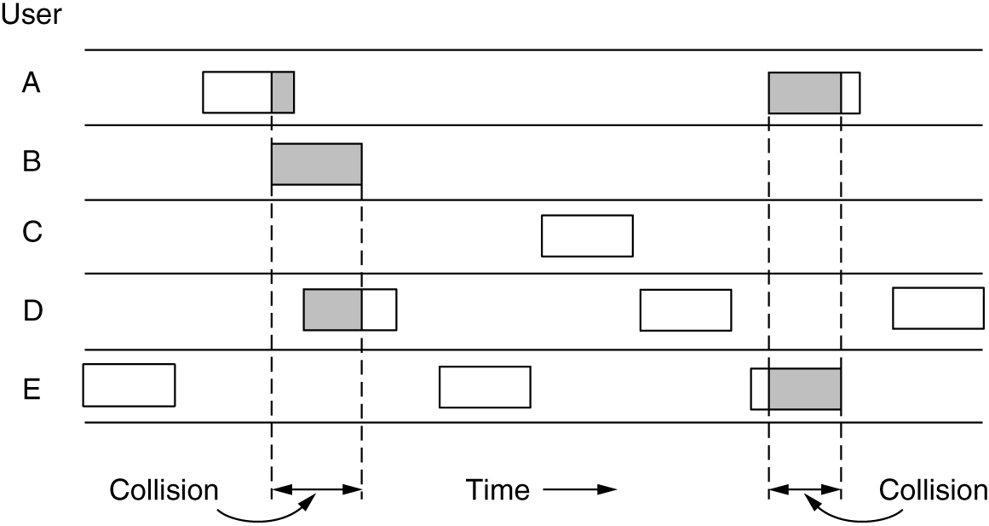
ALOHA (2 of 4)
In pure ALOHA, frames are transmitted at completely arbitrary times.

Slide 9
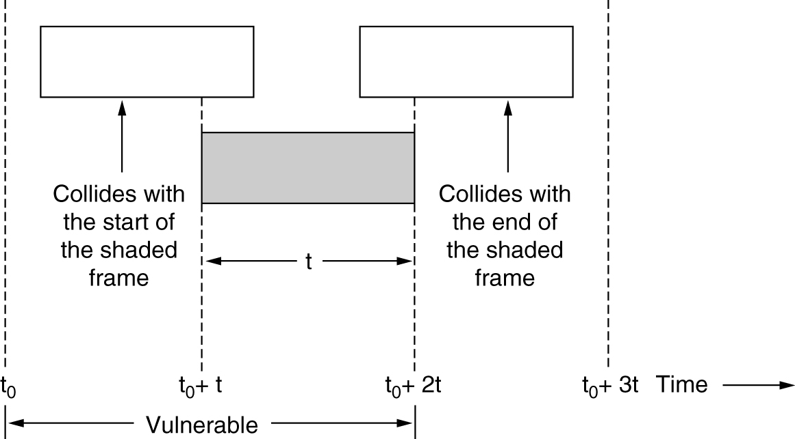
ALOHA (3 of 4)
Vulnerable period for the shaded frame

Slide 10
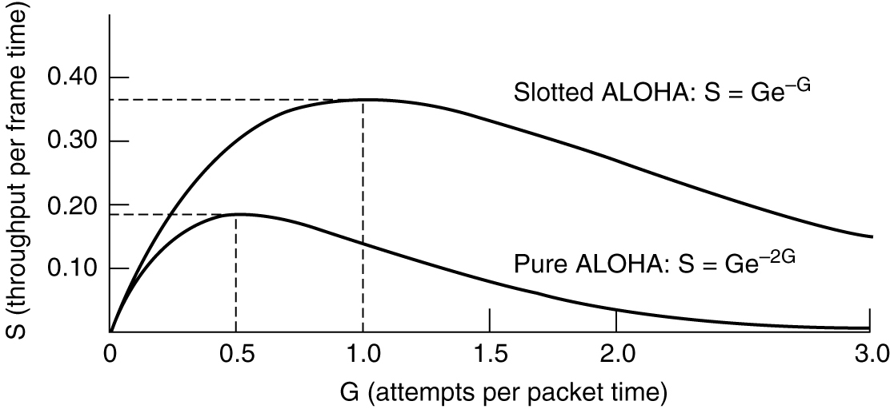
ALOHA (4 of 4)
Throughput versus offered traffic for ALOHA systems

Slide 11
Carrier Sense Multiple Access Protocols
Persistent and non-persistent CSMA
1-persistent CSMA: If the channel is idle, the stations sends its data. Otherwise, the station just waits until it becomes idle.
Nonpersistent CSMA: If the channel is busy, the station does not continually sense it for the purpose of seizing it immediately.
p-persistent CSMA: If the channel is idle, it transmits with a probability p. With a probability , it defers until the next slot.
CSMA with collision detection
Known as CSMA/CD (CSMA with Collision Detection)
Quickly detect the collision and abruptly stop transmitting
Basis of the classic Ethernet LAN

Slide 12
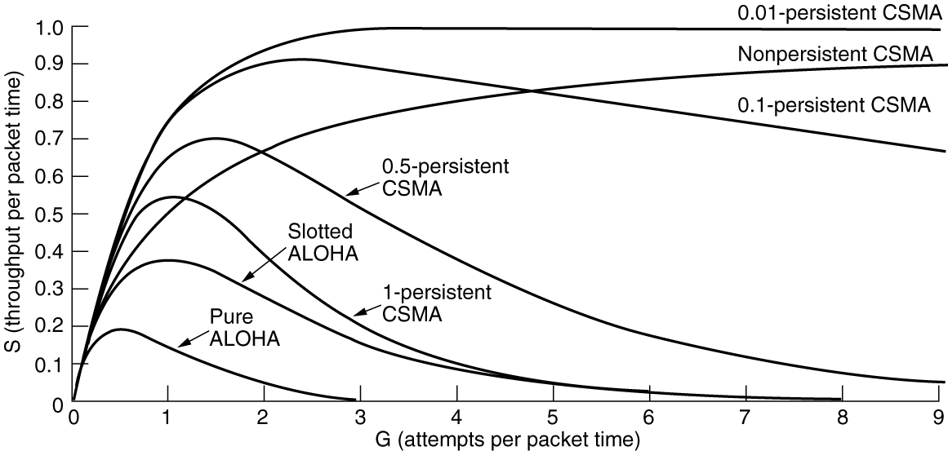
Persistent and Nonpersistent CSMA
Comparison of the channel utilization versus load for various random access protocols

Slide 13
Collision-Free Protocols
Bit-map protocol
Basic bit-map method
Reservation protocols
Token passing
Token bus
Binary countdown
-- As soon as a station sees that a high-order bit position that is 0 in its address has been overwritten with a 1, it gives up

Slide 14
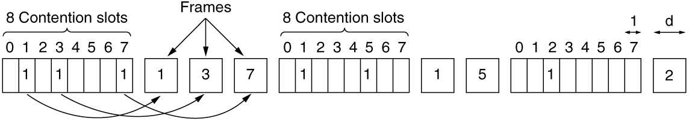
A Bit-Map Protocol
The basic bit-map protocol

Slide 15
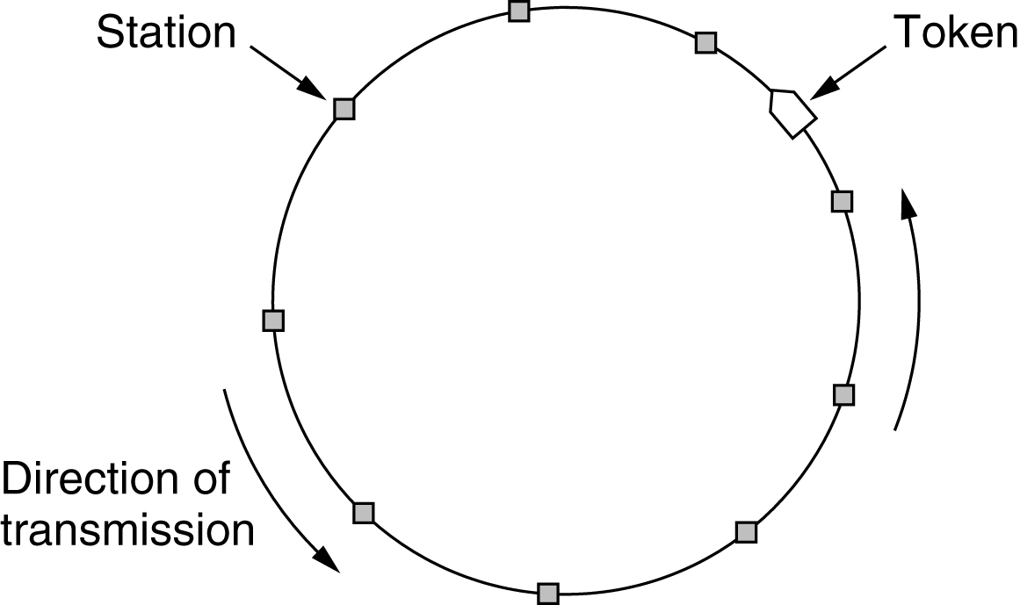
Token Passing
Token ring

Slide 16
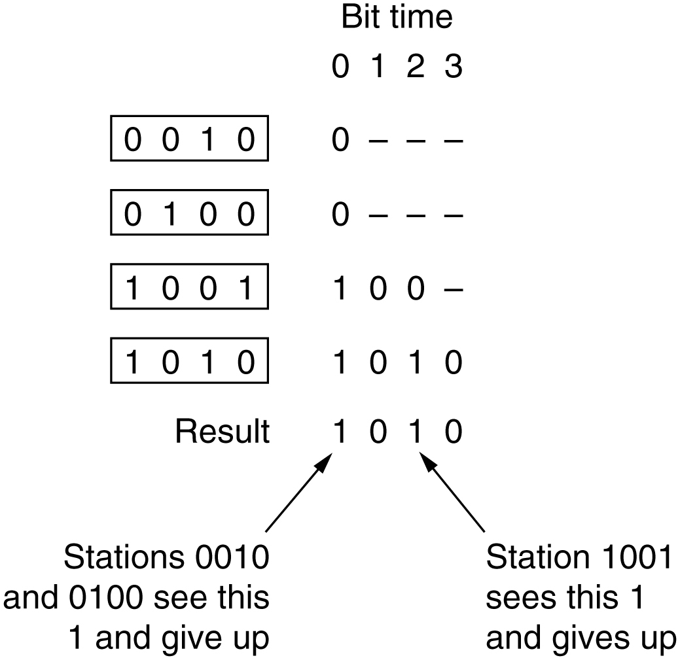
Binary Countdown
The binary countdown protocol. A dash indicates silence.

Slide 17
Limited-Contention Protocols (1 of 2)
Combines the best properties of the contention and collision-free protocols
Limited-contention protocol
Use contention at low load to provide low delay
Used a collision-free technique at high load to provide good channel efficiency
Asymmetric protocols
The adaptive tree-walk protocol

Slide 18
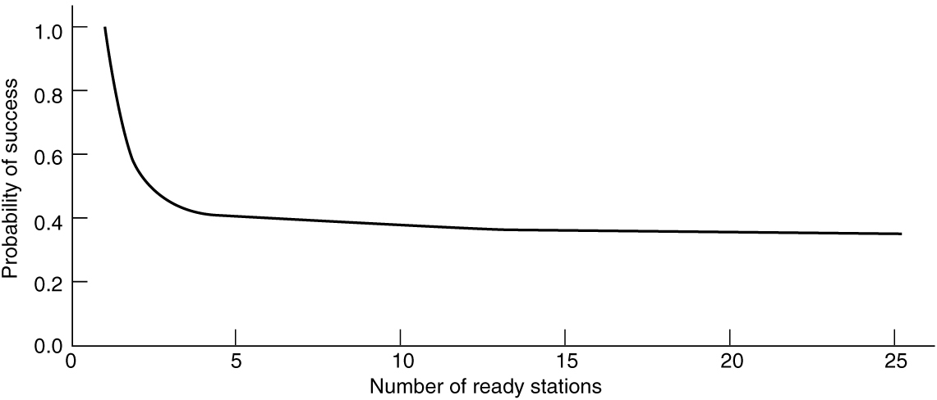
Limited-Contention Protocols (2 of 2)
Acquisition probability for a symmetric contention channel

Slide 19
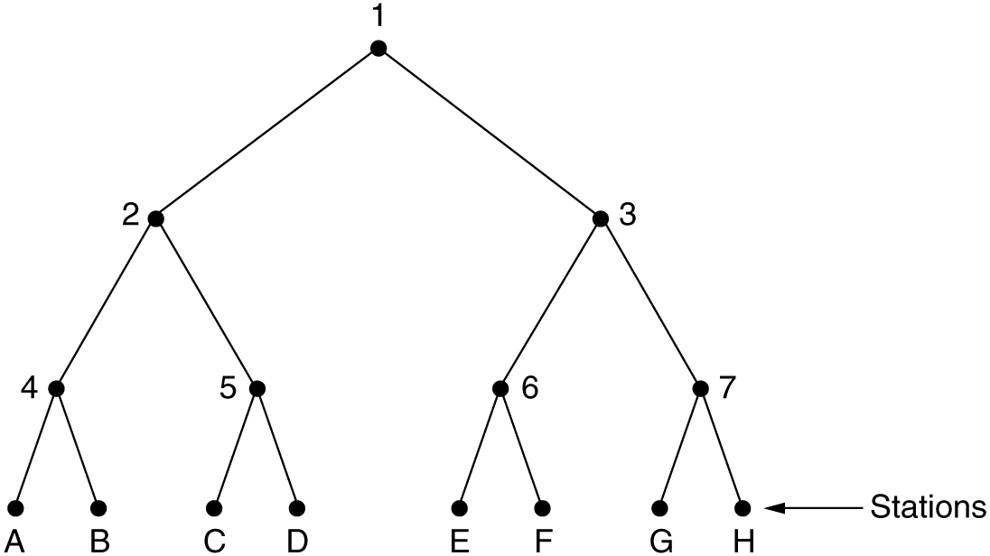
The Adaptive Tree-Walk Protocol
The tree for eight stations

Slide 20
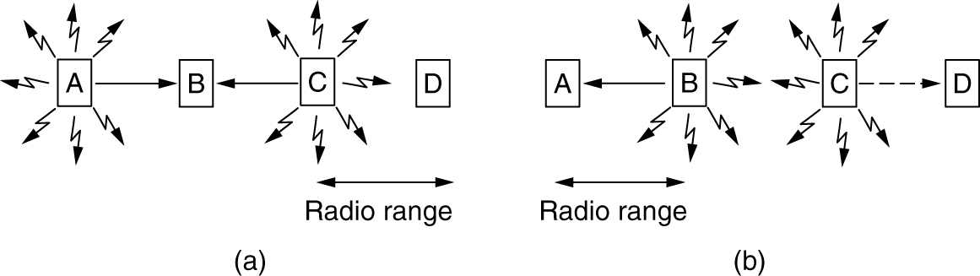
Wireless LAN Protocols (1 of 2)
A wireless LAN. (a) A and C are hidden terminals when transmitting to B. (b) B and C are exposed terminals when transmitting to A and D.

Slide 21
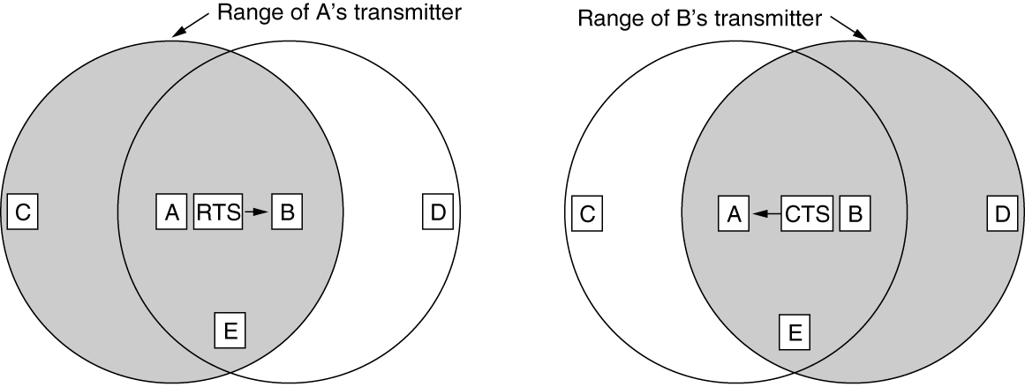
Wireless LAN Protocols (2 of 2)
The basic idea behind it is for the sender to stimulate the receiver into outputting a short frame, so stations nearby can detect this transmission and avoid transmitting for the duration of the upcoming (large) data frame.
The MACA protocol. (a) A sending an RTS to B. (b) B responding with a CTS to A.

Slide 22
Ethernet (1 of 2)
Classic Ethernet physical layer
Classic Ethernet MAC sublayer protocol
CSMA/CD with binary exponential backoff
Ethernet performance
Switched Ethernet
Fast Ethernet

Slide 23
Ethernet (2 of 2)
Gigabit Ethernet
10-Gigabit Ethernet
40- and 100-Gigabit Ethernet
Retrospective on Ethernet

Slide 24
Ethernet (2 of 2)
The story of Ethernet starts about the same time as that of ALOHA, when a student named Bob Metcalfe got his bachelor’s degree at M.I.T. and then started his Ph.D. at Harvard.
He became so interested in it that, he decided to spend the summer in Hawaii working with Abramson before starting work at PARC (Palo Alto Research Center).
Using his knowledge of Abramson’s work, he, together with his colleague David Boggs, designed and implemented the first local area network (Metcalfe and Boggs, 1976).
It used a single long, thick coaxial cable and ran at 3 Mbps.

Slide 25
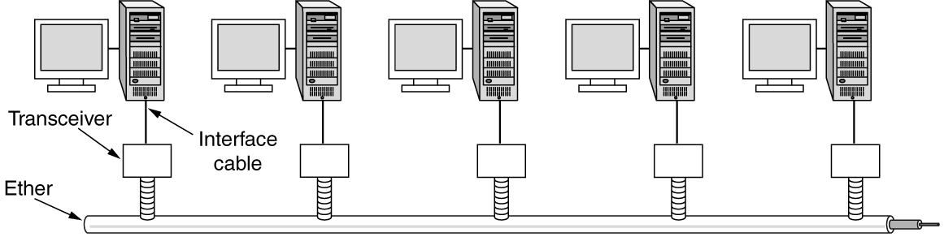
Classic Ethernet Physical Layer
The first variety, popularly called thick Ethernet, resembled a yellow garden hose, with markings every 2.5 meters to show where to attach computers.
It was succeeded by thin Ethernet, which bent more easily and made connections using industry-standard BNC connectors.
Thin Ethernet was much cheaper and easier to install, but it could run for only 185 meters per segment (instead of 500 m with thick Ethernet), each of which could handle only 30 machines (instead of 100).
To allow larger networks, multiple cables can be connected by repeaters.

Slide 26
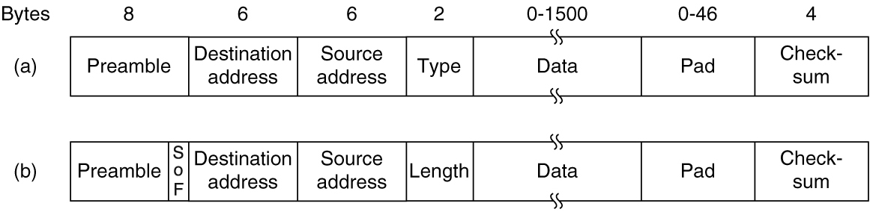
Classic Ethernet MAC Sublayer Protocol (1 of 2)
First comes a Preamble of 8 bytes, each containing the bit pattern 10101010 (with the exception of the last byte, in which the last 2 bits are set to 11).
Sending to a group of stations is called multicasting. The special address consisting of all 1 bits is reserved for broadcasting.
An interesting feature of station source addresses is that they are globally unique, assigned centrally by IEEE
If the data portion of a frame is less than 46 bytes, the Pad field is used to fill out the frame to the minimum size.
Frame formats. (a) Ethernet (DIX). (b) IEEE 802.3.

Slide 27
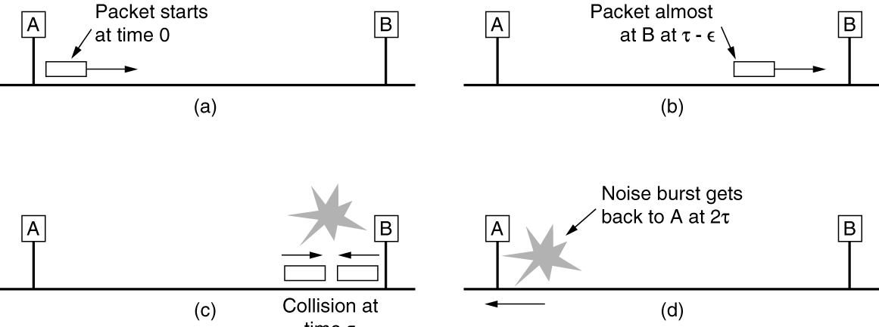
Classic Ethernet MAC Sublayer Protocol (2 of 2)
Another (and more important) reason for having a minimum length frame is to prevent a station from completing the transmission of a short frame before the first bit has even reached the far end of the cable, where it may collide with another frame.
Collision detection can take as long as 2t.

Slide 28
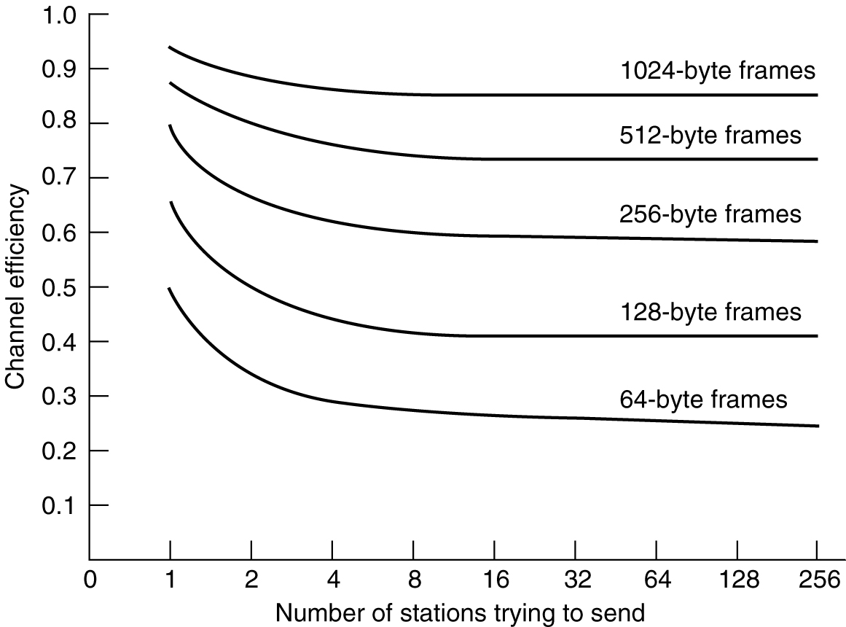
Ethernet Performance
Efficiency of Ethernet at 10 Mbps with 512-bit slot times

Slide 29
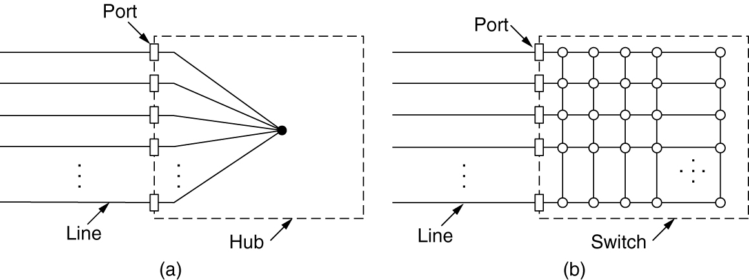
Switched Ethernet (1 of 2)
The wires were telephone company twisted pairs, since most office buildings were already wired this way and normally plenty of spares were available.
This reuse was a win, but it did reduce the maximum cable run from the hub to 100 meters (200 meters if high-quality Category 5 twisted pairs were used).
Adding or removing a station is simpler in this configuration, and cable breaks can be detected easily.
(a) Hub. (b) Switch.

Slide 30
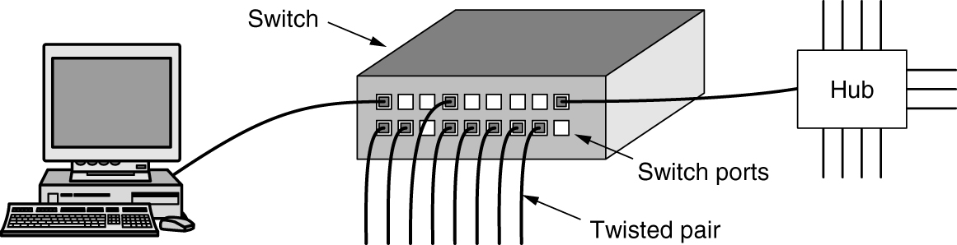
Switched Ethernet (2 of 2)
When a switch port receives an Ethernet frame from a station, the switch checks the Ethernet addresses to see which port the frame is destined for.
The switch then forwards the frame over its high-speed backplane to the destination port.
The destination port then transmits the frame on the wire so that it reaches the intended station.
An Ethernet switch

Slide 31
Switched Ethernet (2 of 2)
In a hub, all stations are in the same collision domain. They must use the CSMA/CD algorithm to schedule their transmissions.
In a switch, each port is its own independent collision domain. Collisions are now impossible, and CSMA/CD is not needed.
A switch improves performance over a hub in two ways. First, since there are no collisions, the capacity is used more efficiently. Second, and more importantly, with a switch multiple frames can be sent simultaneously (by different stations).

Slide 32
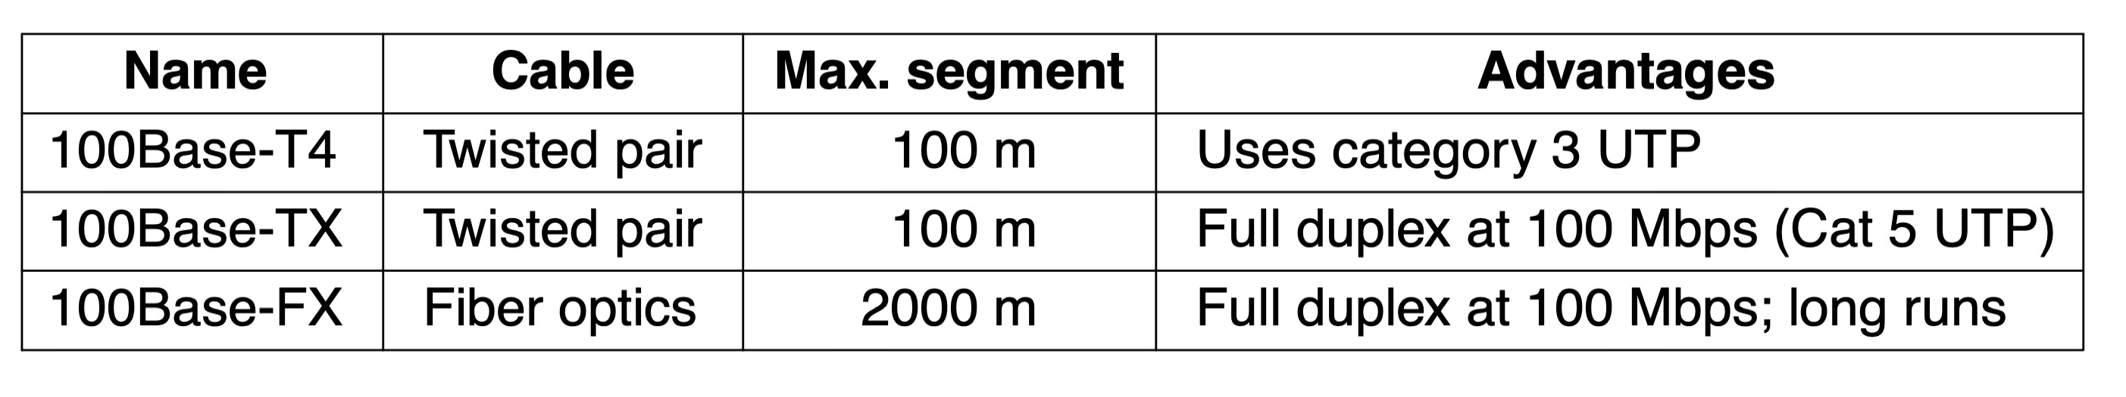
Fast Ethernet
The basic idea behind fast Ethernet was simple: keep all the old frame formats, interfaces, and procedural rules, but reduce the bit time from 100 nsec to 10 nsec.
The original fast Ethernet cabling

Slide 33
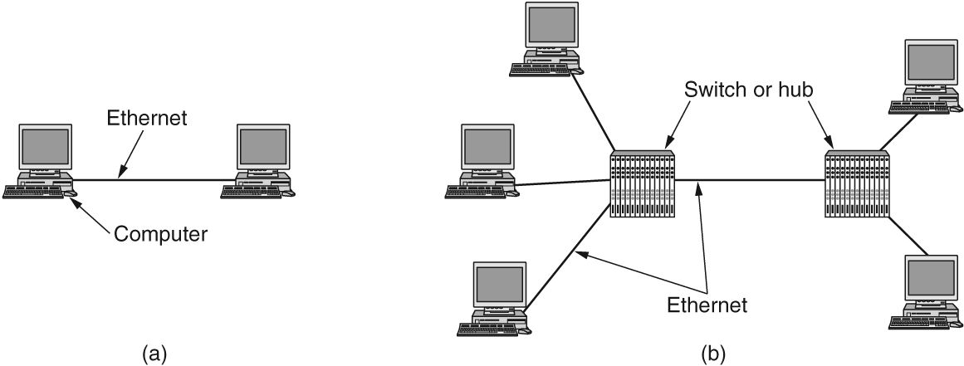
Gigabit Ethernet (1 of 2)
Like fast Ethernet, all configurations of gigabit Ethernet use point-to-point links.
(a) A two-station Ethernet. (b) A multistation Ethernet.

Slide 34
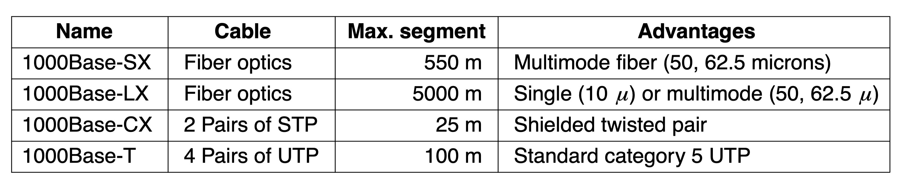
Gigabit Ethernet (2 of 2)
Gigabit Ethernet cabling

Slide 35
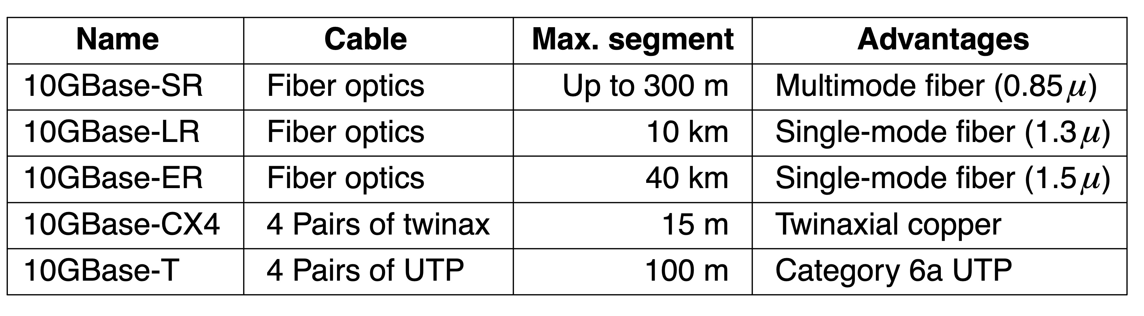
10-Gigabit Ethernet
10-Gigabit Ethernet cabling

Slide 36
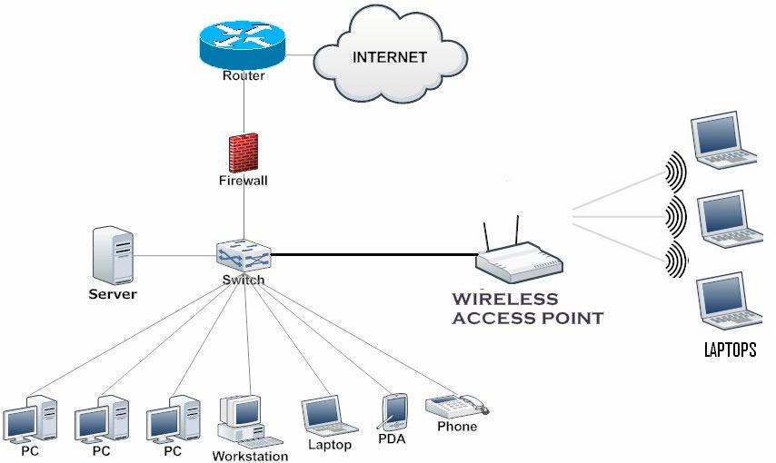
Small home office

Slide 37
Your turn
Design a network for SMU networking lab using ethernet.
Concern
1. How many devices?
2. Area of the room?
3. How many hub or switch?
4. How many router?
5. What kind of cable?
6. Anything else?

Slide 38
Wireless LANs
802.11 architecture and protocol stack
802.11 physical layer
802.11 MAC sublayer protocol
802.11 frame structure
Services

Slide 39
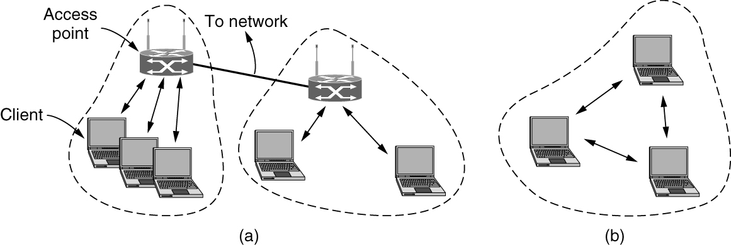
The 802.11 Architecture and Protocol Stack (1 of 2)
In infrastructure mode, each client is associated with an AP (Access Point) that is in turn connected to the other network. The client sends and receives its packets via the AP. Several access points may be connected together, typically by a wired network called a distribution system.
802.11 architecture. (a) Infrastructure mode. (b) Ad-hoc mode.

Slide 40
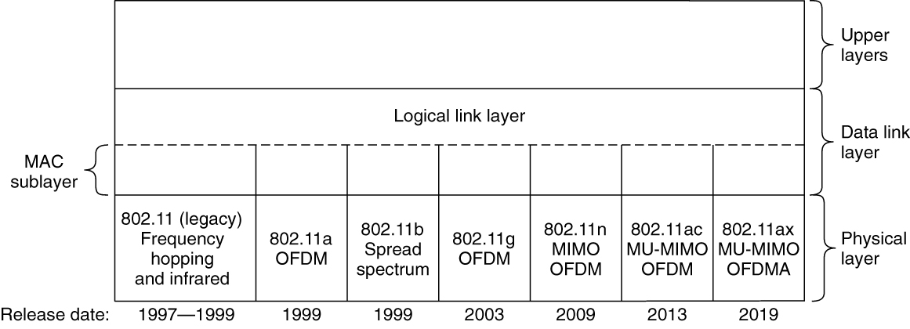
The 802.11 Architecture and Protocol Stack (2 of 2)
Part of the 802.11 protocol stack

Slide 41
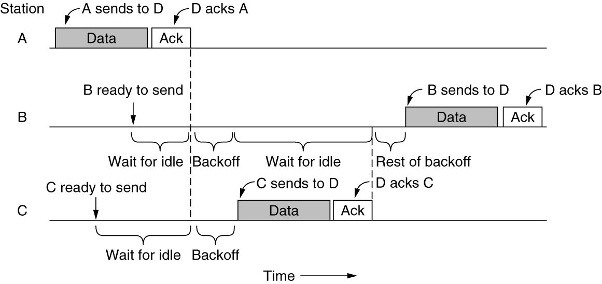
The 802.11 MAC Sublayer Protocol (1 of 4)
Sending a frame with CSMA/CA

Slide 42
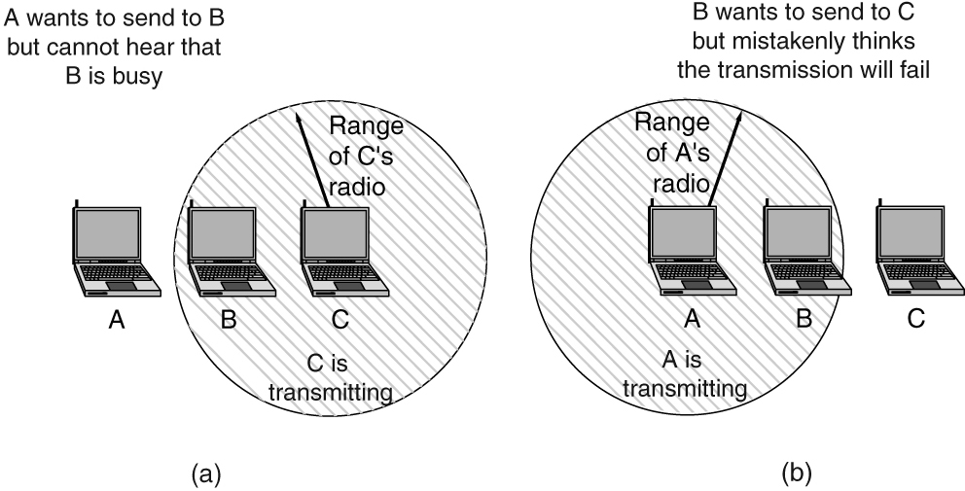
The 802.11 MAC Sublayer Protocol (2 of 4)
(a) The hidden terminal problem. (b) The exposed terminal problem.

Slide 43
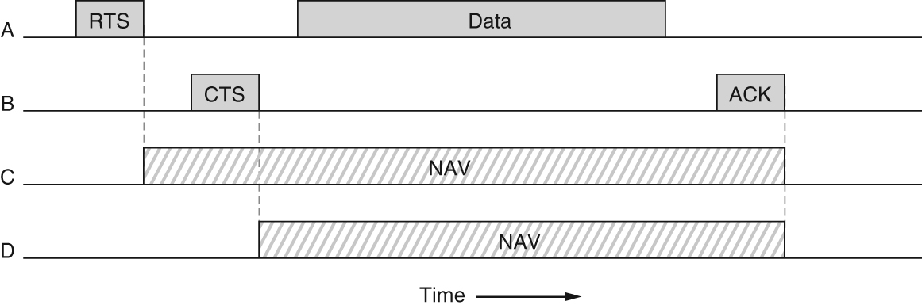
The 802.11 MAC Sublayer Protocol (3 of 4)
With virtual sensing, each station keeps a logical record of when the channel is in use by tracking the NAV (Network Allocation Vector).
Virtual channel sensing using CSMA/CA

Slide 44
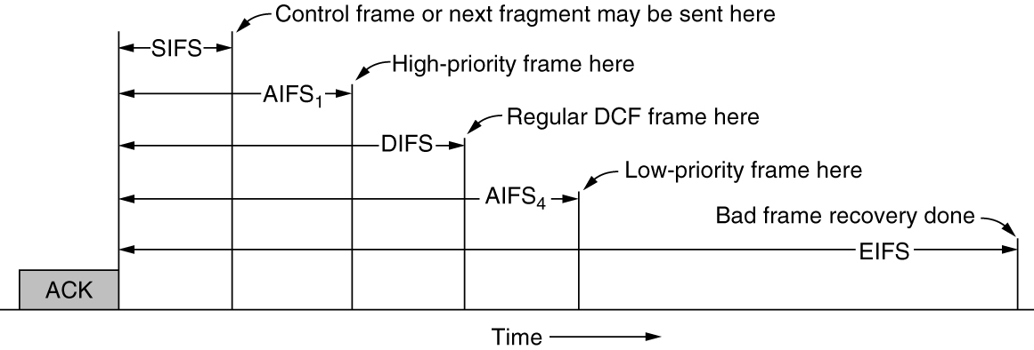
The 802.11 MAC Sublayer Protocol (4 of 4)
Interframe spacing in 802.11

Slide 45
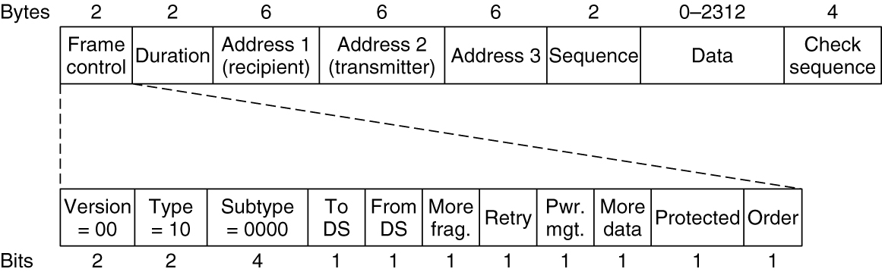
The 802.11 Frame Structure
Format of the 802.11 data frame

Slide 46
Services
Association and data delivery
Security and privacy
Prioritization and power control

Slide 47
Bluetooth
Bluetooth architecture
Bluetooth applications
Bluetooth protocol stack
Bluetooth radio layer
Bluetooth link layers
Bluetooth frame structure
Bluetooth 5

Slide 48
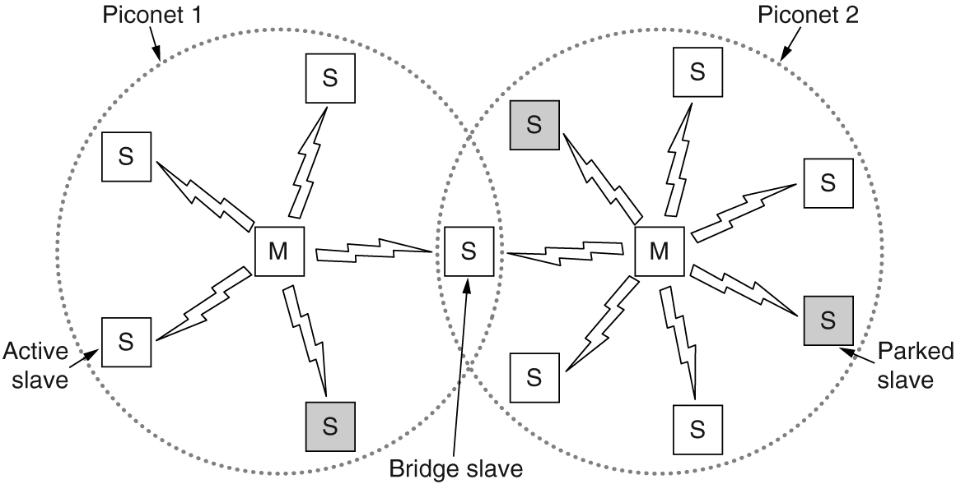
Bluetooth Architecture
The basic unit of a Bluetooth system is a piconet, which consists of a controller node and up to seven active worker nodes within a distance of 10 meters. An interconnected collection of piconets is called a scatternet.
Two piconets can be connected to form a scatternet

Slide 49
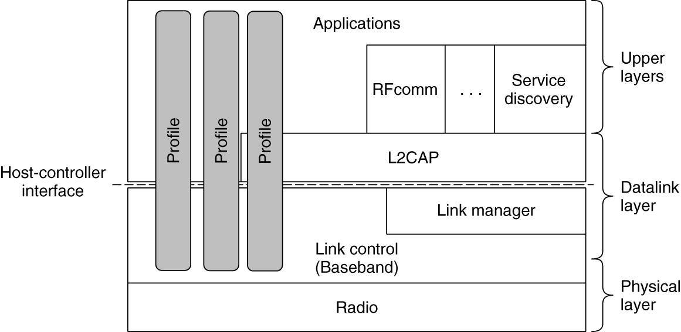
The Bluetooth Protocol Stack
The link control (or baseband) layer includes elements of the physical layer. It deals with how the controller controls time slots and how these slots are grouped into frames.
The link manager handles the establishment of logical channels between devices, including power management, pairing and encryption, and quality of service.
L2CAP (Logical Link Control Adaptation Protocol) frames variable-length messages and provides reliability if needed.
The Bluetooth protocol architecture

Slide 50
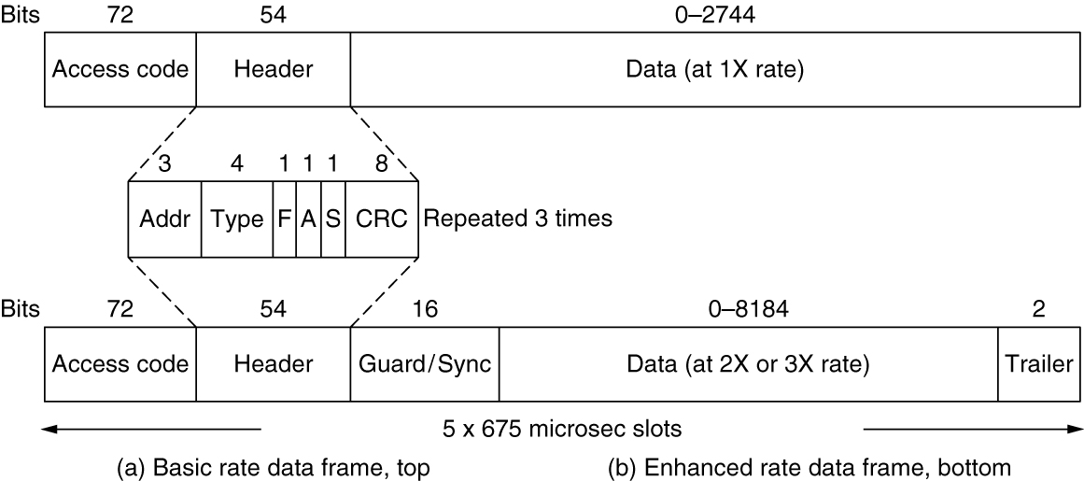
The Bluetooth Frame Structure
It begins with an access code that usually identifies the controller so that workers within radio range of two controllers can tell which traffic is for them. Next comes a 54-bit header containing typical MAC sublayer fields. If the frame is sent at the basic rate, the data field comes next.
Typical Bluetooth data frame at (a) basic and (b) enhanced data rates.

Slide 51
Bluetooth 5
Support for Internet of Things devices
Speed increased from 1 Mbps to 2 Mbps
Message size has gone up from 31 bytes to 255 bytes
Range indoors has gone up from 10 m to 40 m
Power requirements have been reduced slightly
Slightly better security

Slide 52
DOCSIS
Overview
MAC sublayer performs channel allocation, configuration of quality of service, unique forwarding model
Uses a standard MAC frame format
Ranging
Cable modem transmits a ranging request
CMTS (headend) determines the network delay to the cable modem and performs necessary power adjustment
Channel bandwidth allocation
Service flows
Request-grant process and low-latency DOCSIS

Slide 53
Data Link Layer Switching
Uses of bridges
Learning bridges
Spanning tree bridges
Repeaters, hubs, bridges, switches, routers, and gateways
Virtual LANs
The IEEE 802.1Q standard

Slide 54
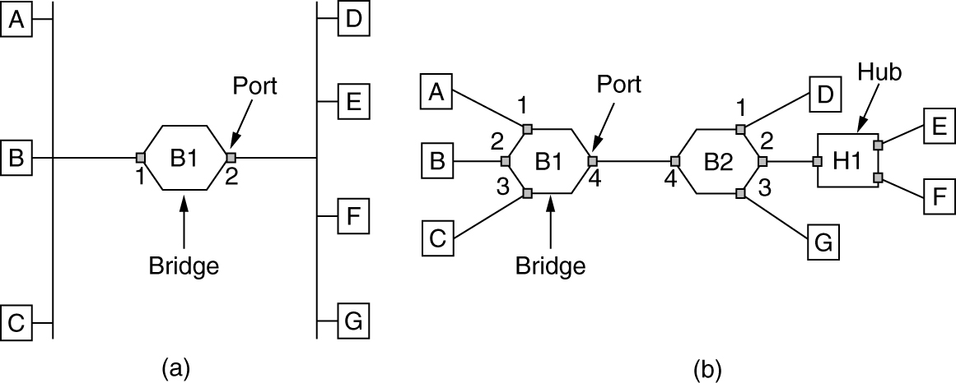
Learning Bridges (1 of 2)
(a) Bridge connecting two multidrop LANs. (b) Bridges (and a hub) connecting seven point-to-point stations.

Slide 55
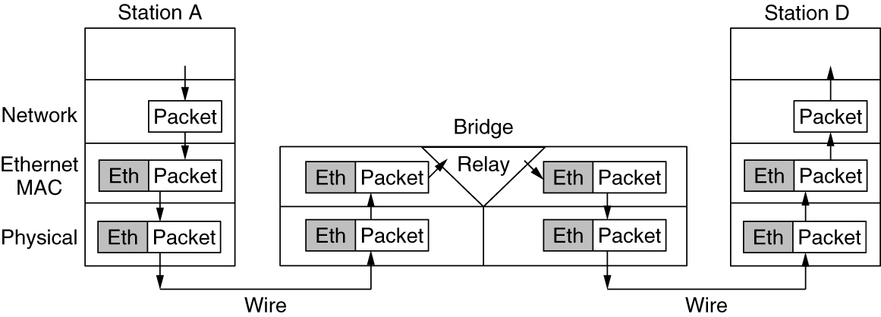
Learning Bridges (2 of 2)
Protocol processing at a bridge

Slide 56
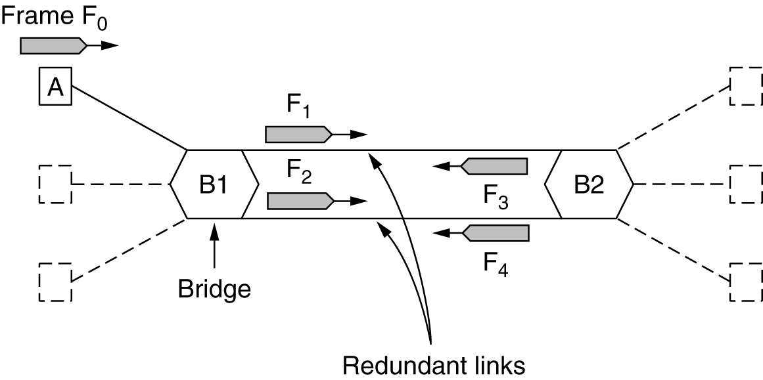
Spanning-Tree Bridges (1 of 4)
Bridges with two parallel links

Slide 57
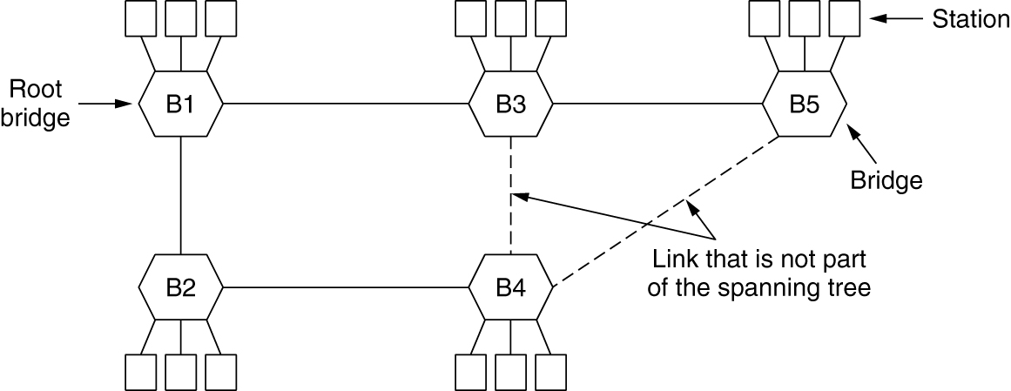
Spanning-Tree Bridges (2 of 4)
A spanning tree connecting five bridges. The dashed lines are links that are not part of the spanning tree.

Slide 58
Spanning-Tree Bridges (3 of 4)
I think that I shall never see
A graph more lovely than a tree.
A tree whose crucial property Is loop-free connectivity.
A tree which must be sure to span.
So packets can reach every LAN.

Slide 59
Spanning-Tree Bridges (4 of 4)
First the Root must be selected
By ID it is elected.
Least-cost paths from Root are traced
In the tree these paths are placed.
A mesh is made by folks like me
Then bridges find a spanning tree.
-- Radia Perlman

Slide 60
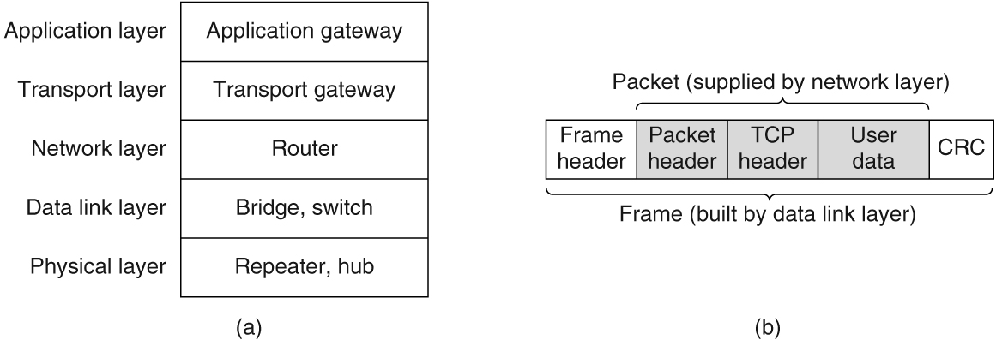
Repeaters, Hubs, Bridges, Switches, Routers, and Gateways
(a) Which device is in which layer. (b) Frames, packets, and headers.

Slide 61
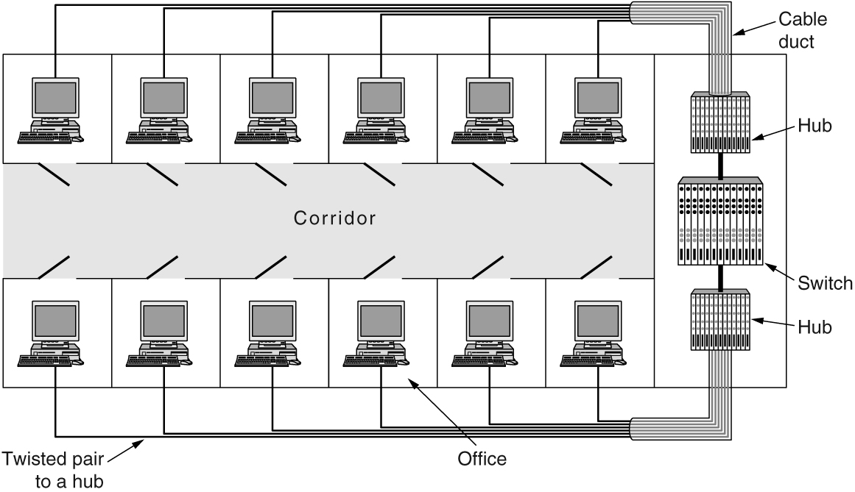
Virtual LANs (1 of 2)
A building with centralized wiring using hubs and a switch

Slide 62
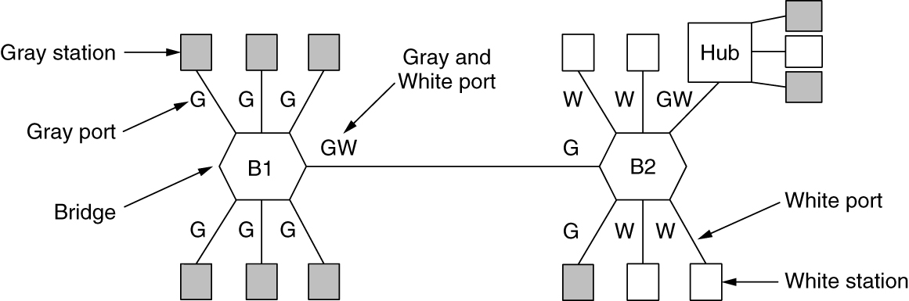
Virtual LANs (2 of 2)
Two VLANs, gray and white, on a bridged LAN

Slide 63
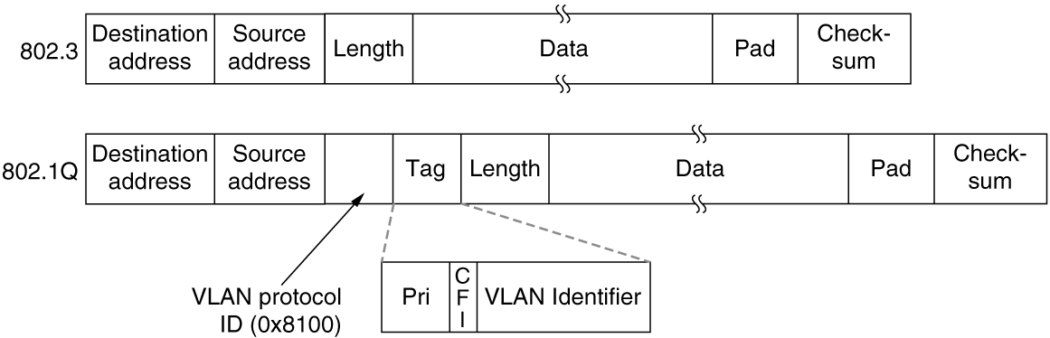
The IEEE 802.1Q Standard (2 of 2)
The 802.3 (legacy) and 802.1Q Ethernet frame formats

Slide 64

Copyright
This work is protected by United States copyright laws and is provided solely for the use of instructors in teaching their courses and assessing student learning. Dissemination or sale of any part of this work (including on the World Wide Web) will destroy the integrity of the work and is not permitted. The work and materials from it should never be made available to students except by instructors using the accompanying text in their classes. All recipients of this work are expected to abide by these restrictions and to honor the intended pedagogical purposes and the needs of other instructors who rely on these materials.

